Slide 1

Predicting Yearly Medical Costs Using Synthetic Patient Data
Stony Brook University Data Science Bootcamp Capstone Project
Diana Kulawiec

Slide 2

Introduction
Can a machine learning model be developed to predict yearly medical encounter costs from synthetic patient data?
Which factors have the most important impact on healthcare expenses?

Slide 3
The Process
Data Generation
Data Wrangling
Exploratory Data Analysis
Final Model Selection
Model Training and Development
Data Imputation

Slide 4

Data Generation
Downloaded synthetic patient data from Synthea for 100 living patients from each of the 50 states
CSV files:
Patients
Encounters
Medications
Procedures
Immunizations
Allergies
Observations

Slide 5
Data Wrangling
Patients
Demographic information
Encounters
Number of medical encounters and cost
Observations
Patient vital signs and lab reports
Final Dataset
5000 rows, 60 columns
Allergies
Number of allergies
Medications
Number of medications and cost
Immunizations
Number of immunizations and cost
Procedures
Number of procedures and cost

Slide 6
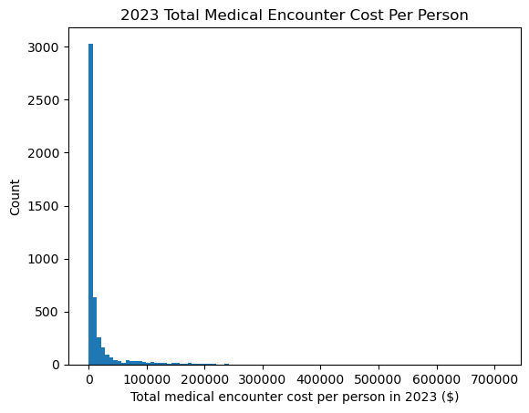
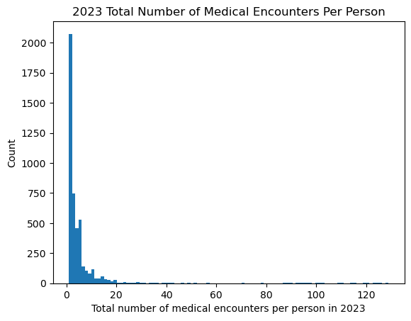
Medical Encounters Distributions

Slide 7
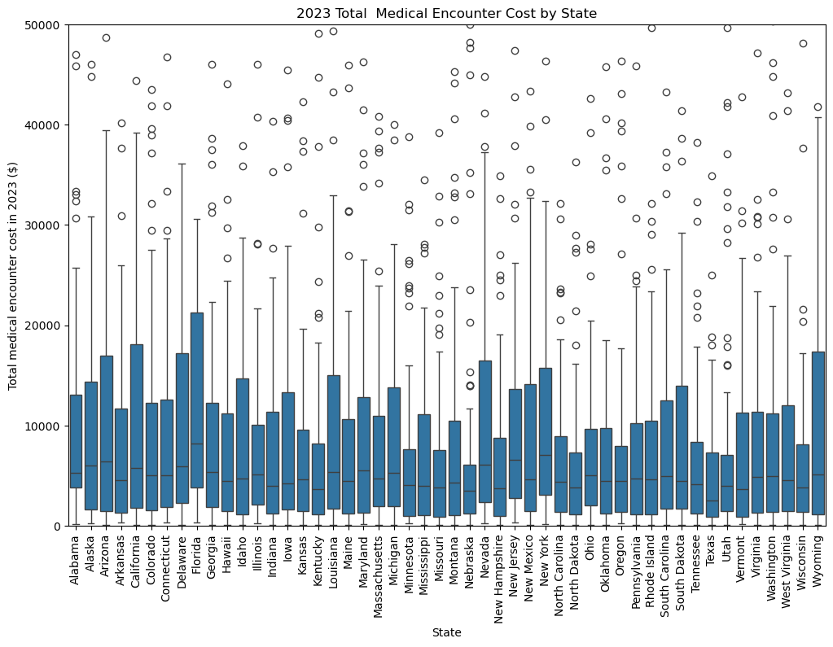
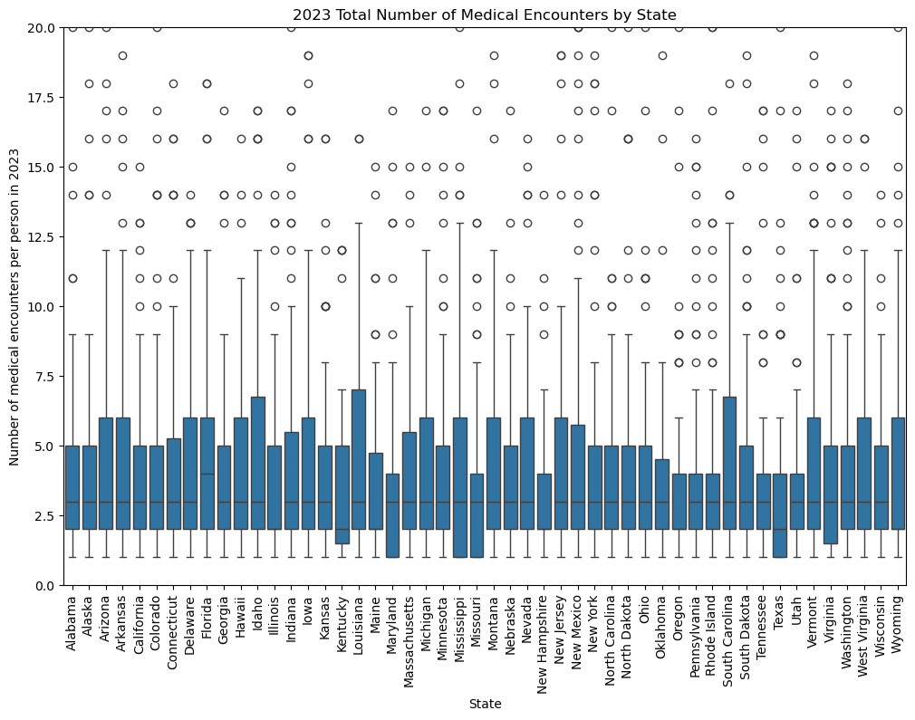
Medical Encounters by State

Slide 8
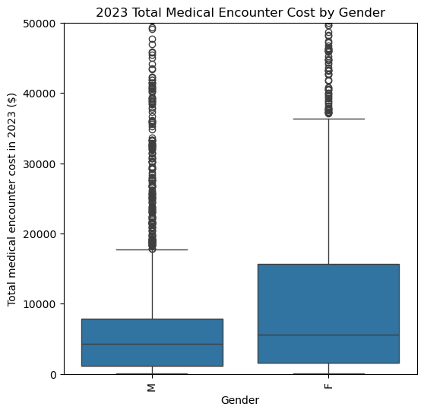
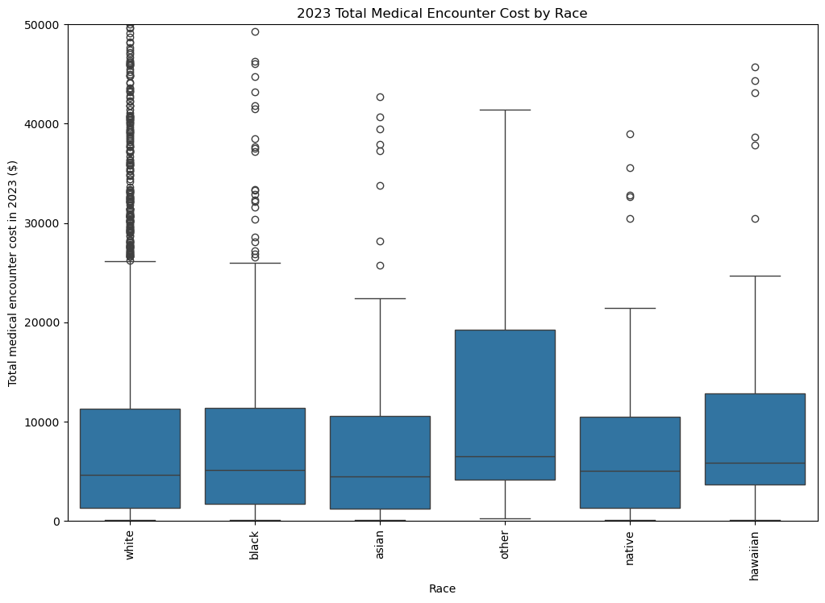
Medical Encounters by Gender and Race

Slide 9
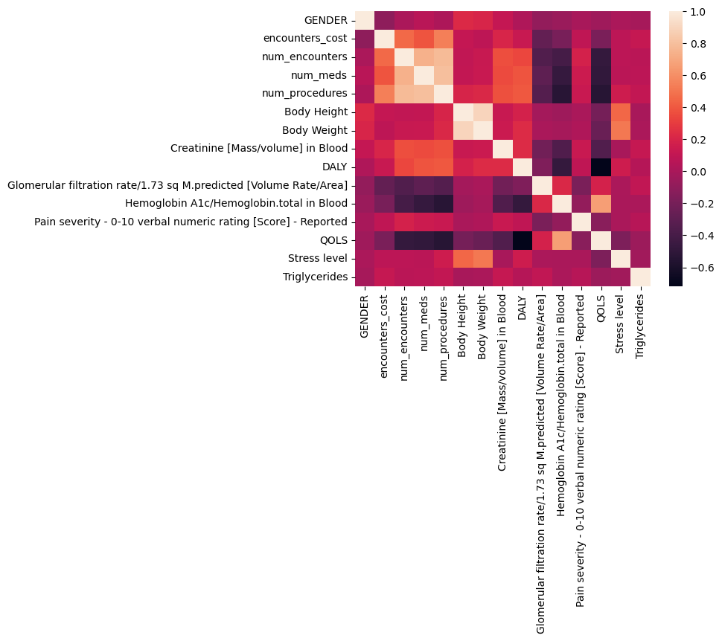
Exploratory Data Analysis

Slide 10
Data Imputation
Imputation Technique | R-Squared Value
Mean | 0.4934
Median | 0.4941
K Nearest Neighbor (KNN) | 0.5313
Multivariate Imputation by Chained Equations (MICE) | 0.5139
Tested 4 different imputation techniques to fill in missing values
Assessed R-squared values and distribution shape
Selected K Nearest Neighbor

Slide 11
Model Training and Development
Split data into training (75%) and testing (25%) sets
Baseline model – mean value of the training set (dummy regression)
Evaluated R-squared and mean absolute error (MAE)
Mean value of training data | 15,040.24
Training R-squared | 0.0000
Testing R-squared | -0.0006
Training MAE | 18,029.71
Testing MAE | 17,276.07

Slide 12
Linear Regression Models
 | Linear Regression | Ridge Regression | Lasso Regression
Training R-squared | 0.4464 | 0.4073 | 0.4223
Testing R-squared | -0.1396 | 0.2567 | 0.4184
Training MAE | 13,050.87 | 12,431.39 | 12,130.95
Testing MAE | 12,799.56 | 12,021.69 | 11,354.02

Slide 13
Ensemble Models
 | Random Forest | Gradient Boosting
Training R-squared | 0.9426 | 0.9475
Testing R-squared | 0.6350 | 0.6404
Training MAE | 2,519.64 | 4,236.62
Testing MAE | 6,167.80 | 6,439.04

Slide 14
Final Model Selection - Random Forest
Random forest model was selected
Included the best 45 features and 80 trees in the forest
R-squared – 0.9495
Mean absolute error – 2,379.54

Slide 15
Final Model Selection - Random Forest
Random Forest Model vs. Dummy Regression Model
Percent change training R-squared | 100.00%
Percent change testing R-squared | 100.10%
Percent change training MAE | 615.57%
Percent change testing MAE | 180.10%

Slide 16
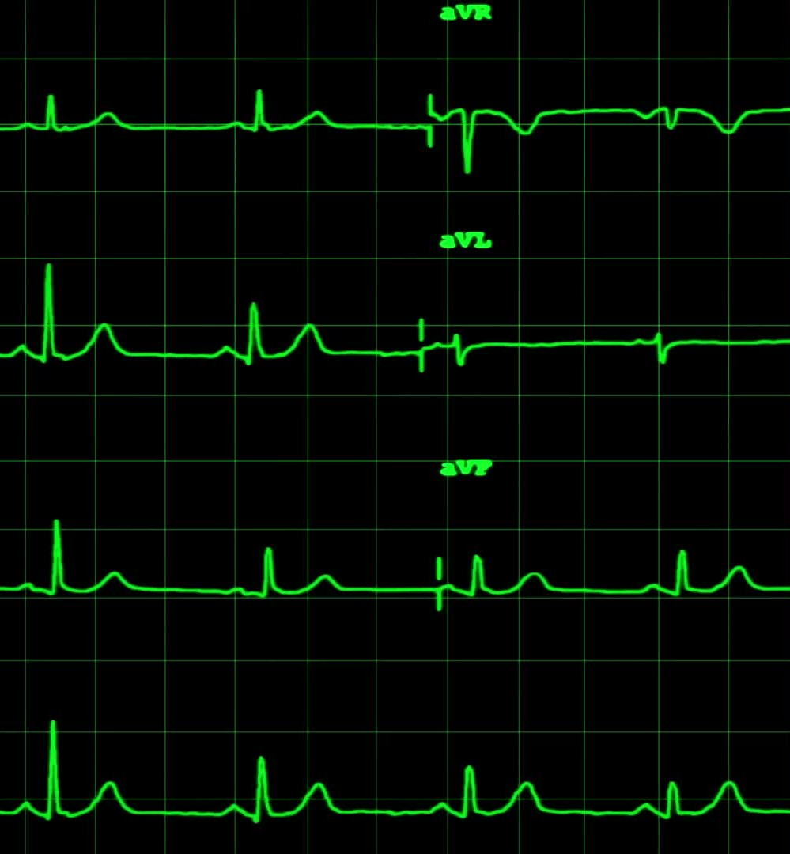
Final Model Selection – Top Features
Number of medical encounters
Number of medical procedures
DALY (disability-adjusted life year
Body mass index (BMI)
Pain severity - 0-10 verbal numeric rating
Age
Medications cost
Cholesterol in HDL [Mass/volume]
Number of medications

Slide 17

Conclusion
Developed a machine learning model to predict yearly medical encounter costs from synthetic patient data
On average, this model is expected to estimate a patient's yearly medical encounters cost within about $2,500
Future work:
Include different types of data
Test multiple years

